Slide 1
Business Process Mapping
Master Class
Dennis Broere
15 June 2023
Internal use only

Slide 2

Welcome to the Master Class Business Process Mapping (BPM)
In this 75 minutes we are going to:
Introduce BPM and the benefits it can bring
Provide some hands-on guidance to start BPM yourself
Do some actual BPM

Slide 3

Typical issues that we all face
You are looking for a description how we do the things we do?
You need to take over an unfinished job from a colleague from another office/country
You want to know which tool you need to use for a task
You want to optimize the way we work
…

Slide 4

Business Process Mapping – current situation
We have many processes within RHDHV, related to delivering our services to our clients.
Many of these processes do not have a clear description.
This makes it difficult for (new) colleagues to know what our way of working is.
This also causes risks, like:
  Losing valuable knowledge when a colleague leaves;
  Clients having different experiences while working with us because we do not have a standardized way of working;
  Time wasted on finding out ‘how to’

Slide 5
Why? To capture best practice approach
To have guidance on the (sequence of) tasks to be undertaken:
  For a consistent and efficient approach
  For training purposes (f.e. newcomers)
  To be explicit to clients on our methodology
  For budget, planning, progress monitoring purposes
Traffic
Forecast
Capacity requirements
Prepare
layout
Check on functional requirements
Financial assessment
Feasibility report

Slide 6
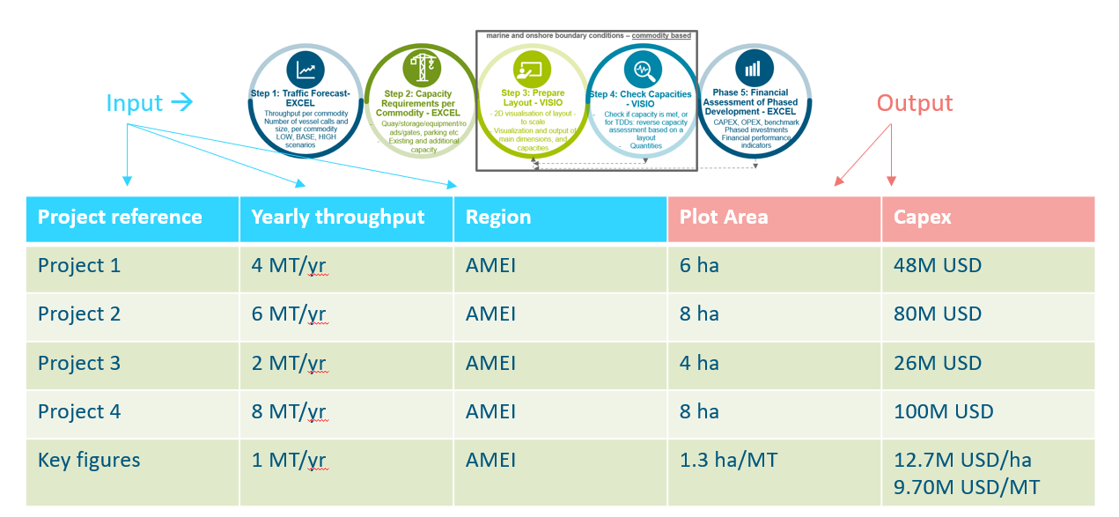
Why? To learn from projects
Systematically linking input to output in standardized way → Key Figures
Input
Output
Assessment

Slide 7
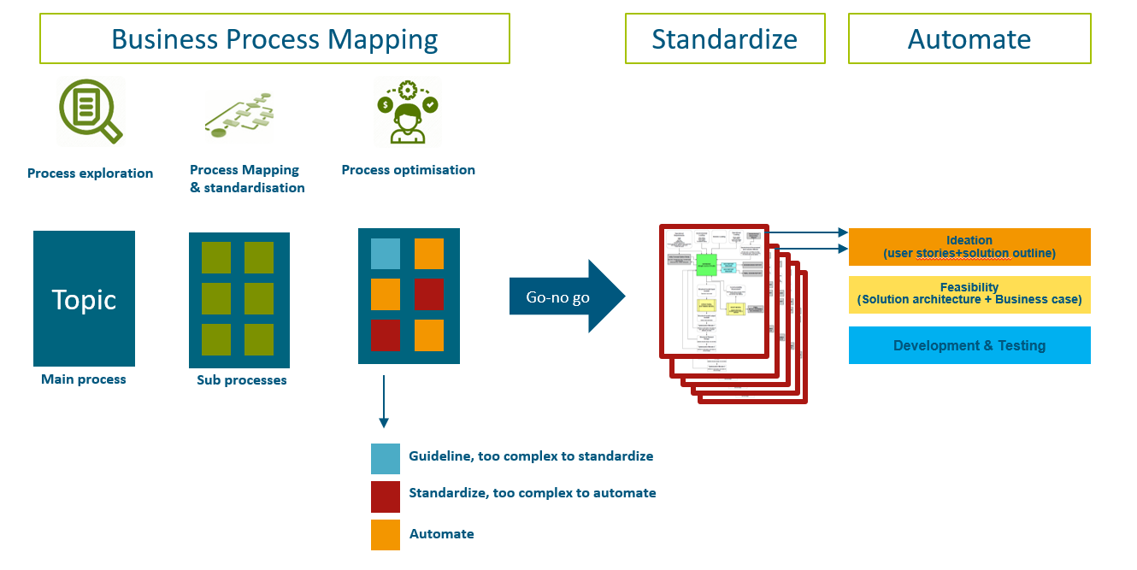
Why? To identify what to automate and what not
An efficient well structured approach allows you to spend more time on the creative parts of your work

Slide 8
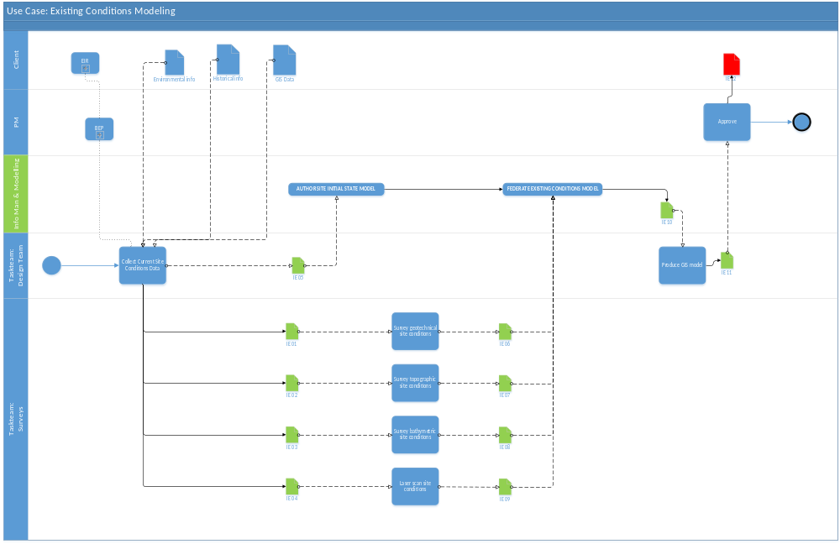
Why? Better Project Management Information
Who gets/needs input from who
Information exchange requirements
Weakest link
Status overview
Duration

Slide 9

Summary on benefits of Business Process Mapping
Uniform way of working, to:
  Facilitate working together between different teams (interface management)
  Have consistency in our approach (Clients expect this)
Quality control and quality assurance:
  A uniform approach reduces the amount of tools, scripts, templates and therefor minimizes maintenance
  Reduce risk of failures making check & control results explicit for you and clients
  More insight for PM by monitoring at process level (physical progress)
Optimize our approach to remain cost competitive
  BPM provides insight, identifies gaps/inefficiencies and allows you to optimize the way we work (f.e. what tasks should be automated first)
Collect & unlock data generating insights for future projects (new services, key figures) by systematically store and link input to the outcome (learning from our projects).

Slide 10
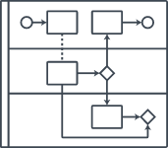

Business Process Mapping – How to?
Business Process Mapping (or BPM) is a method to describe a process.
One method to do BPM is the Swimlane Diagram, providing insight in:
  Task
  The link between tasks
  Who does what
  The sequence of tasks
Team A
Task
Team B
Team C
Link
Time

Slide 11
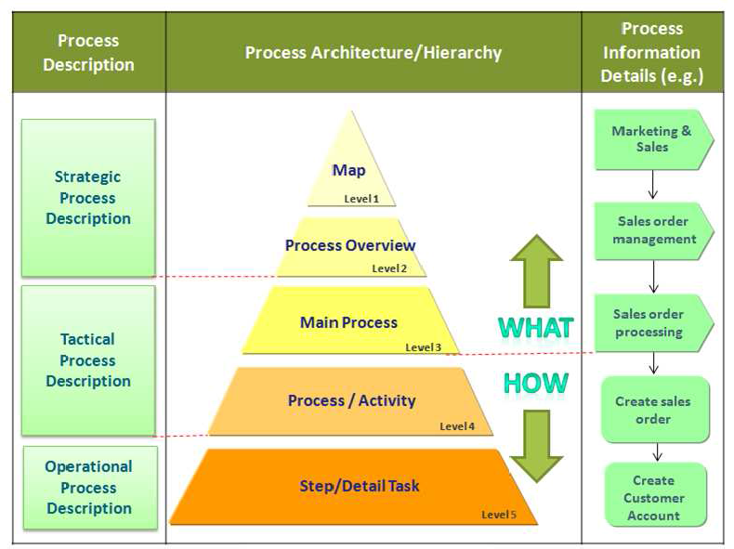
Business Process Levels

Slide 12
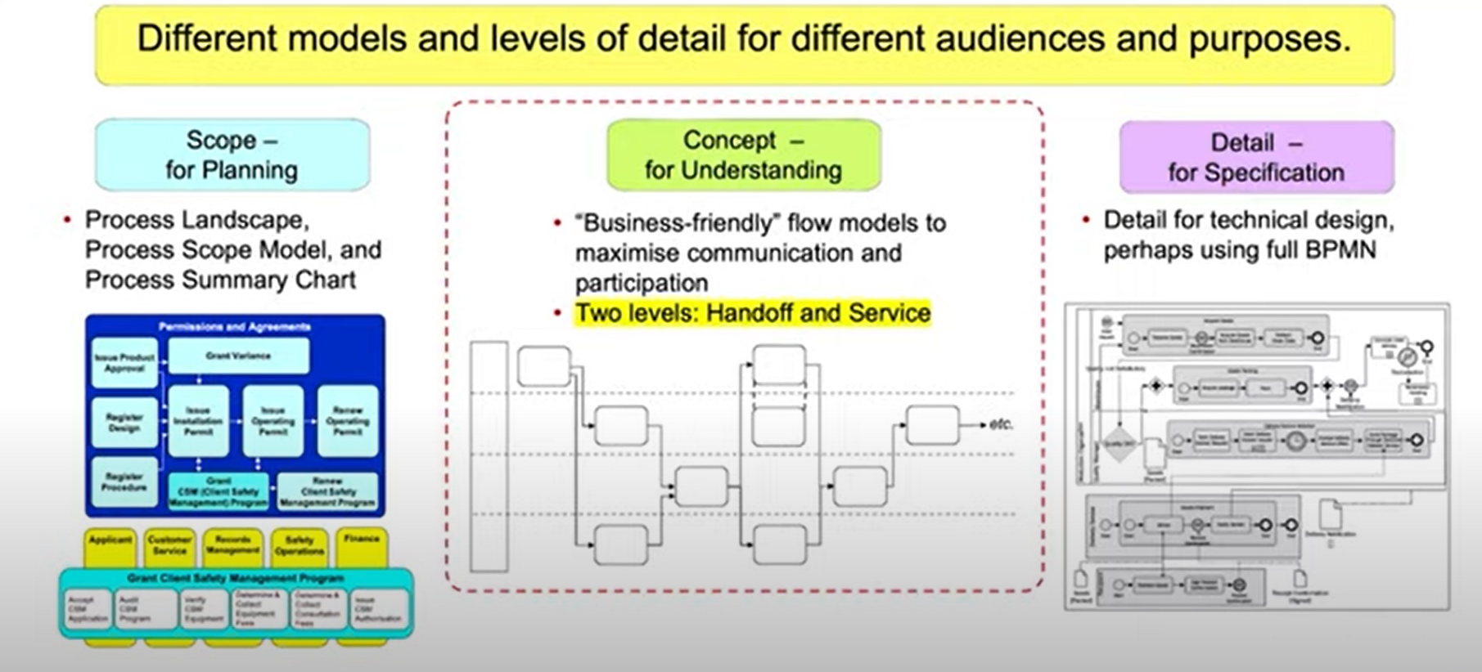
Business Process Levels
Boxes
Boxes & lines
Boxes, lines & widgets

Slide 13
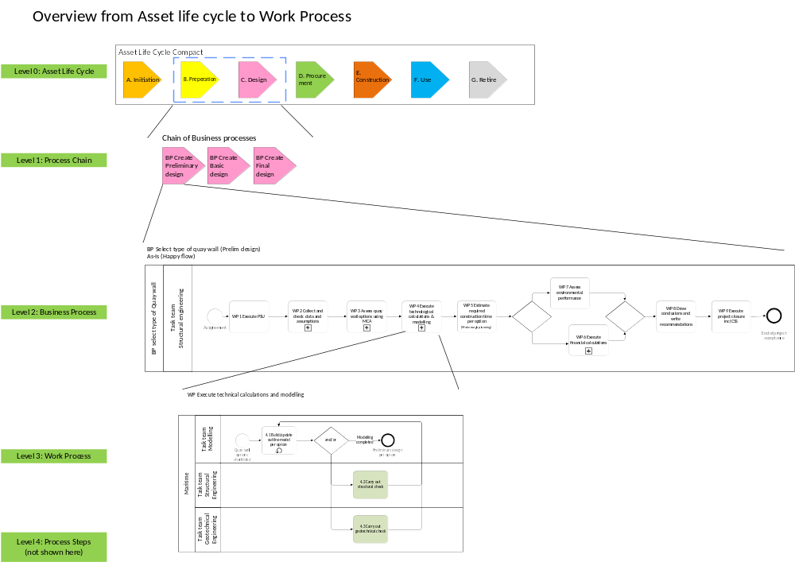
Business Process Levels
Scope - for planning:
Boxes
Concept - for understanding:
Boxes & lines:
Detail - for specification:
Boxes, lines & widgets

Slide 14
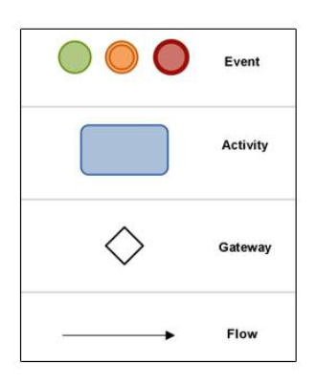
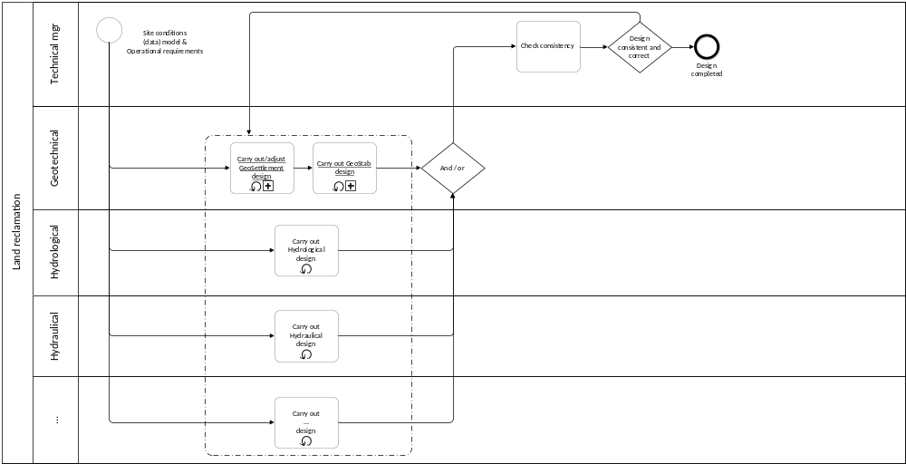
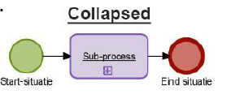
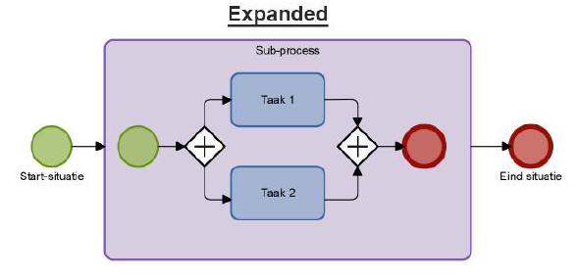
Some definitions… Basic elements
Task or Activity: Defined piece of work, transforming input to output
Sub-process: Collapsed set of tasks
Process: Set of activities describing the work to deliver a service

Slide 15
Example of BPM for Quay wall selection
Link to PDF: Select type of Quay wall BPMSA_Mar_PlusRFI_C04.pdf
Link to W&M Library: https://corporateroot.sharepoint.com/sites/Community-BL-WM-BPMSA

Slide 16
Workshop
Create a process map relevant to your daily work
  Identify a process to map. Tip: Choose something that’s limited in scope and complexity!
  List the activities involved
  Sequence the steps. First tasks on the left side, last task on the right side
  Draw flow chart
  Analyze and optimize the process map
  Optional (scan for automation possibilities)
  Assess which tasks have not been automated yet (f.e. script)
  Setup information exchange log: list for each task:
    input format,
    tool(s),
    output format.

Slide 17
Business Process Map - template
Start event
Verb + Noun
Task
Task team A
Task
Task
Gateway
Task team B
End event
Task
Task team C
Task
Task
Task
Task team D
Task

Slide 18
Information Exchange Log
Task | Input format | Tool | Output format
Collect tidal data (verb+noun) | CSV | Python script | Tidal chart

Slide 19
Examples

Slide 20
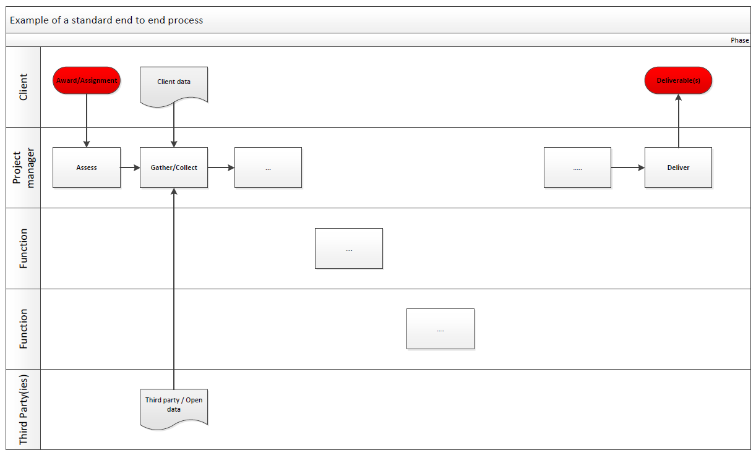
Concept understanding (Simplified information flow)

Slide 21
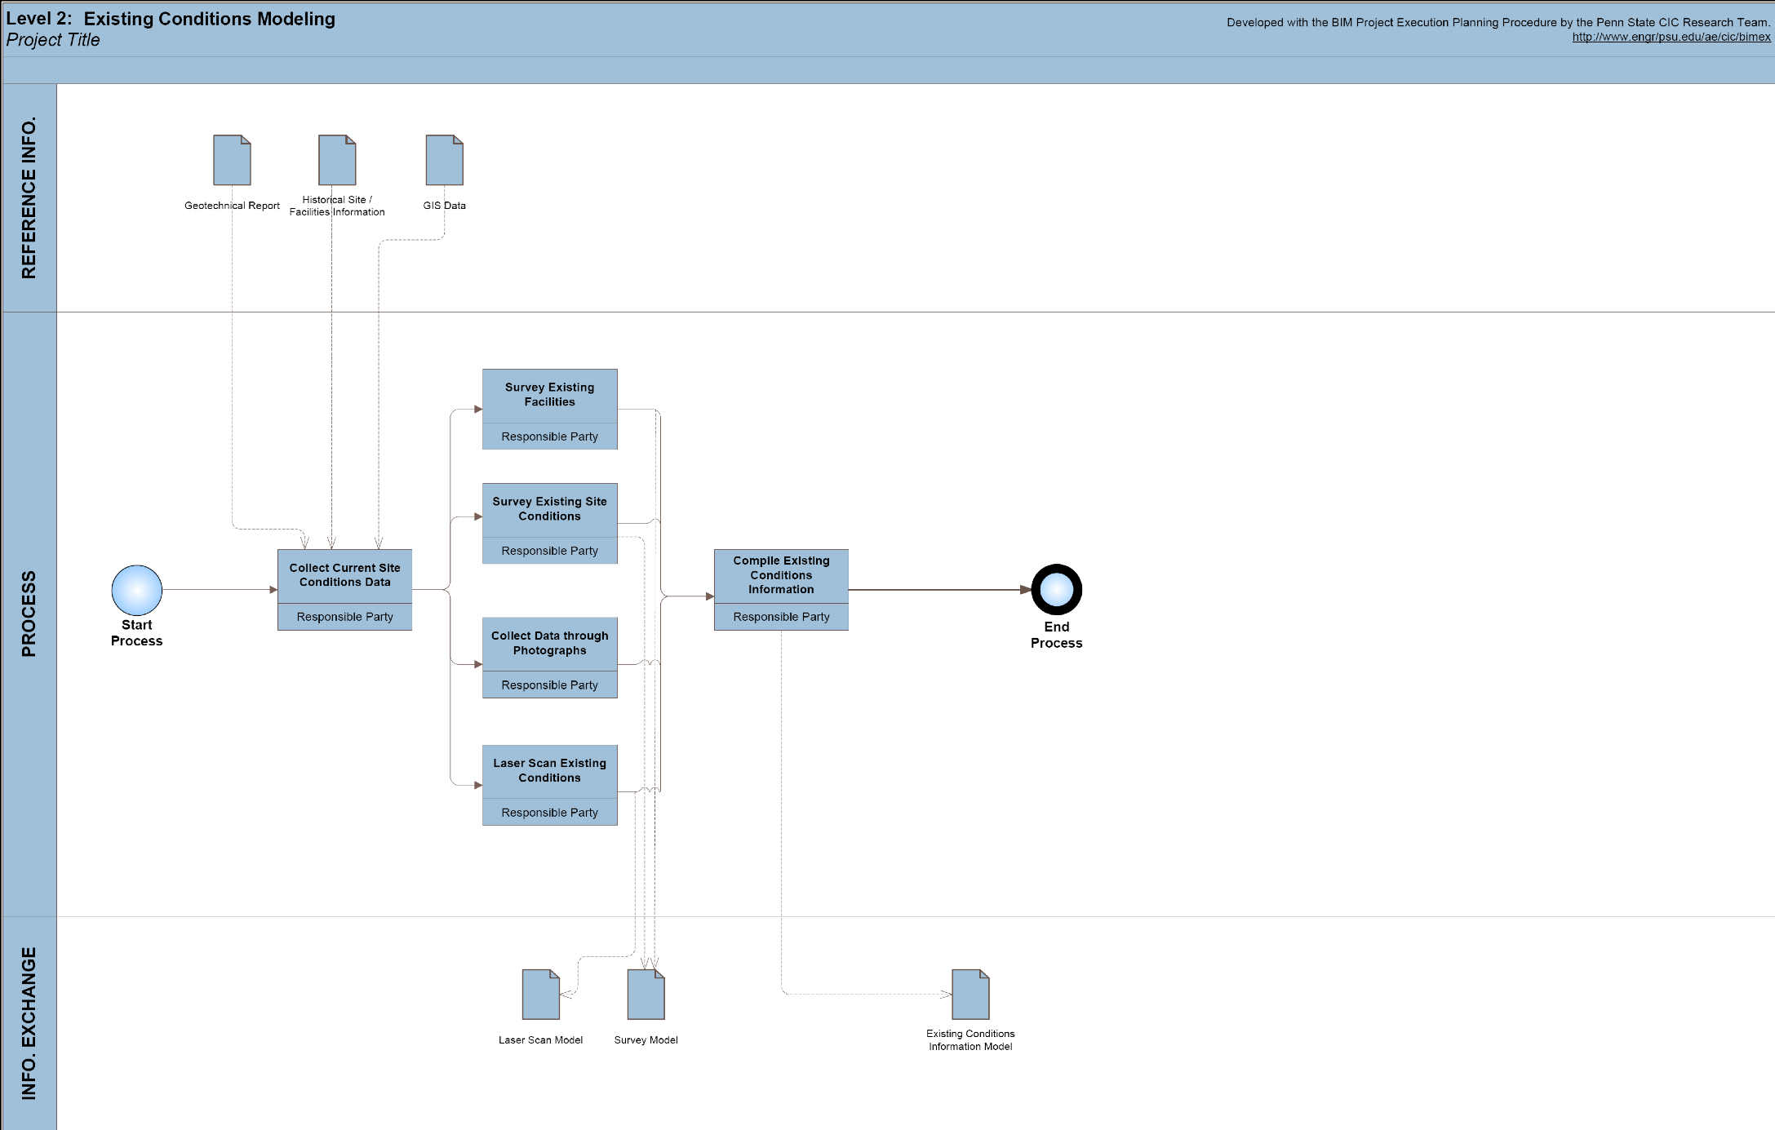
Medium detail (semi simplified information flow)

Slide 22
Detailed (full information flow)

